Slide 1



Cooking Store
Learn cooking with Alexa
Notes:
NOTE: To replace a picture, just select and delete it. Then use the Insert Picture icon to replace it with one of your own!

Slide 2

Cooking store (Use – Case 2)
Cooking store teaches you some easy and medium level recipes to get started in cooking.
There are 50 recipes waiting for you in cooking store, which you can learn by Alexa.
It includes Non veg recipes, Veg recipes, And other recipes like salads, chutneys, snacks, break fast items etc.
All these 50 recipes are collected from various
Books to give the best cooking experience for the
User.

Slide 3

Overview:
All you have to do is to say some simple commands like “Alexa open cooking store” → to open this skill.
Say “start cooking” → To get started with cooking
To know about different menus, try saying
“All Recipes” to know the complete menu of 50 Recipes.
“Veg Recipes” to know about veg recipes you can cook.
“Non Veg Recipes” to know what non veg recipes are included.
“Other Recipes” to learn different recipes like salads, drinks, chutneys etc.

Slide 4
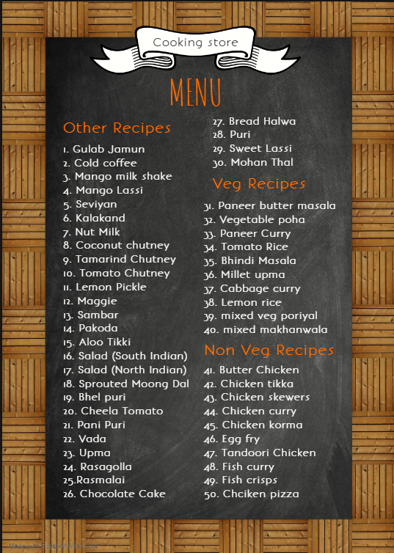
Here is the Menu of all recipes in Cooking Store
And here are some sample utterances and workflow
StartCooking
Ingredients
Tell ingredients
Tutorial
Teach me
Start cooking
Lets start
Get ingredients
Get tutorial
Start tutorial

Slide 5
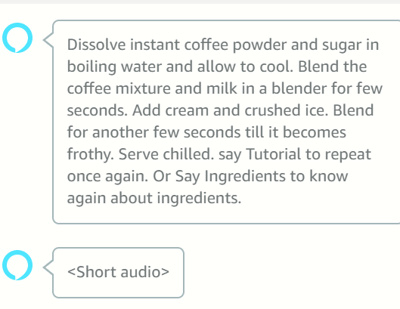
Short and Simple tutorials with Better voice experience

Slide 6
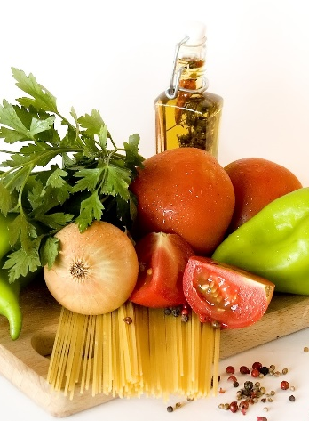

Technical stack used :
Python
(as backend)
Amazon Polly and SSML
(For best voice experience)
Dynamo DB
(For storage)

Slide 7






Shashil Sravan
Cooking store
Vendor ID: M1O56N2HKYZ0IH
amzn1.ask.skill.3da6f3fa-2c84-4158-bb59-1a95b34d6766

